Slide 1
Module 7: Final Project Title: Building A Model to Predict Housing Prices
Author: Virginia Ogozalek

Slide 2
Introduction
What factors affect the sale price of a house?
Size?
Year built?
Number of bathrooms?
Does it have an outdoor deck? If so, how big?
Proximity to good schools?
An apple pie in the oven on open house day?

Slide 3
Introduction
Description:
This project uses data analysis techniques and multiple linear regression to create three different models to predict housing prices based on a dataset for residential houses in Ames, Iowa.
Goal:
Produce models with better predictive accuracy than models presented in a Data Engineering course at MIT.

Slide 4
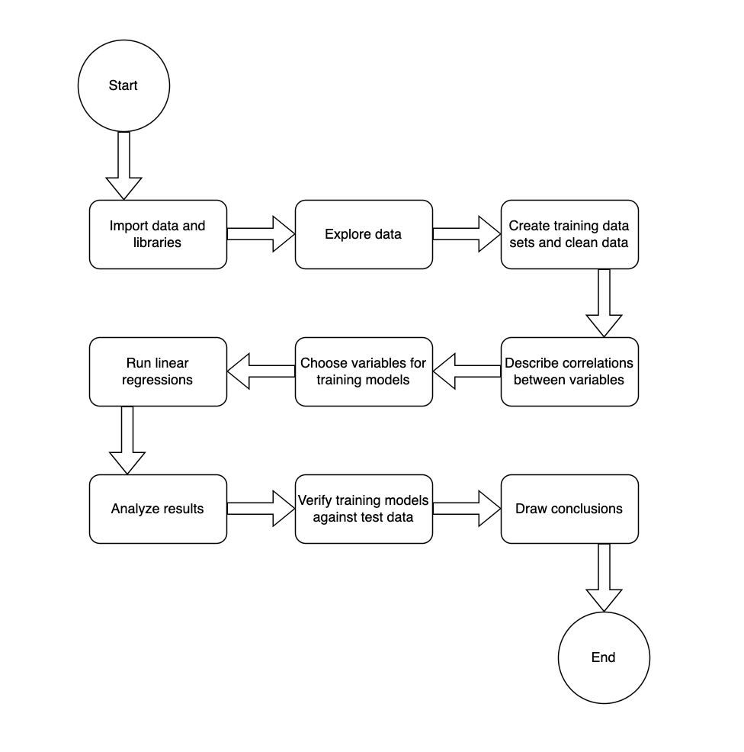
Introduction
Workflow Model

Slide 5
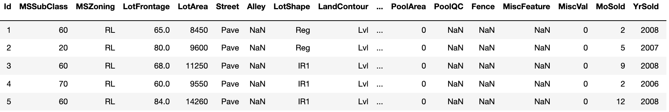
The Data
The dataset used in this project contains 100 observations taken from the 2,930 observations in the Ames, Iowa housing dataset.
The data is read into a Python dataframe . A subset is shown below:
This data has been analyzed extensively. A Google search on "Ames housing dataset" returns 218,000 results!

Slide 6
The Data
The table shows variables that will be used in the regression analysis.
Variable | Description
SalePrice | Sale price of house
OverallQual | Rates the overall material and finish of the house (score of 1–10)
MasVnrArea | Masonry veneer area in square feet
WoodDeckSF | Wood deck area in square feet
FullBath | Full bathrooms above grade
HalfBath | Half baths above grade
BsmtFullBath | Basement full bathrooms
BsmtHalfBath | Basement half bathrooms
GrLivArea | Above grade (ground) living area square feet
GarageArea | Size of garage in square feet
GarageCars | Size of garage in car capacity
YearBuilt | Original construction date|
TotalBsmtSF | Total square feet of basement area

Slide 7
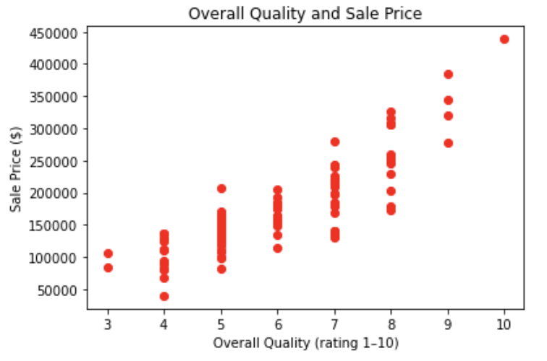
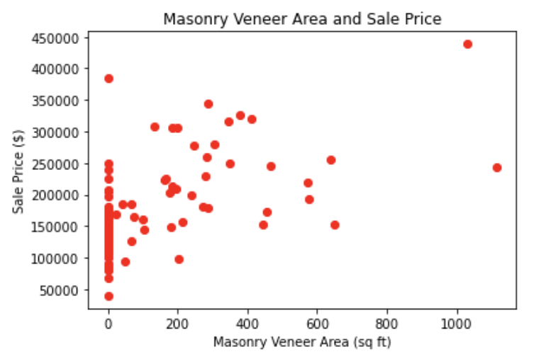
Data Exploration
Independent variables for each model are identified. Scatter plots show the relationship between each independent variable and the dependent variable SalePrice.
The variables for the first MIT model are OverallQual and MasVnrArea.
OverallQual is a discrete numeric variable, while MasVnrArea is continuous. The cluster of points at 0 on the x-axis represent houses without veneers.

Slide 8
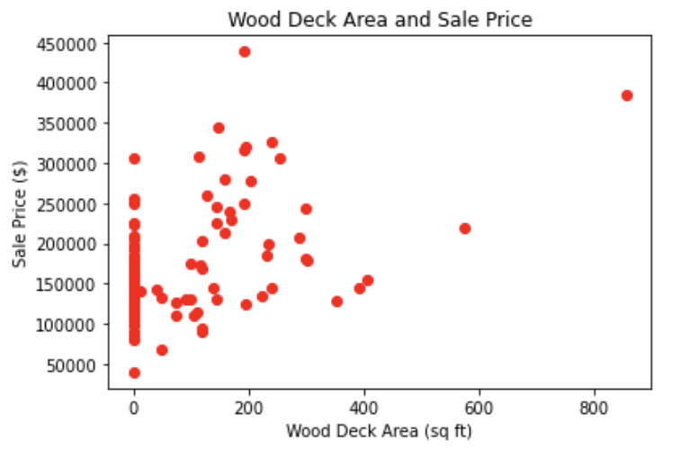
Data Exploration
In Model 1, the variable WoodDeckSF is added to the existing variables in the first MIT model.
WoodDeckSF is a continuous numeric variable. The cluster of points at 0 on the x-axis represent houses without decks.

Slide 9
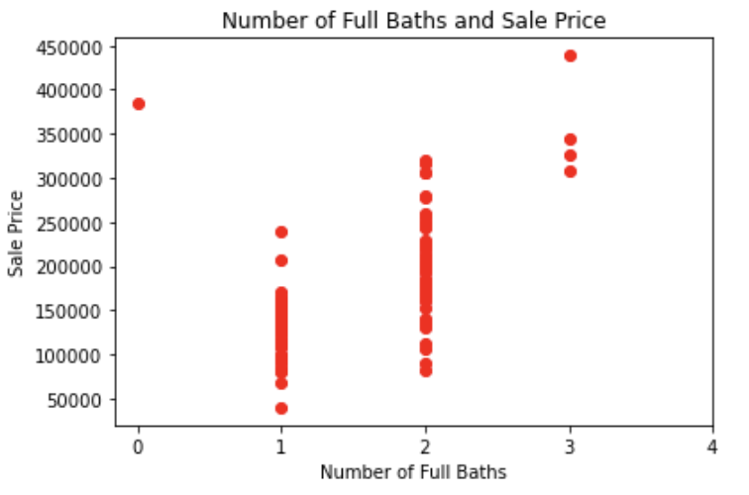
Data Exploration
In Model 2a, the variable FullBath is added to the existing variables in the first MIT model.
FullBath is a discrete numeric variable with only 4 observed values.

Slide 10
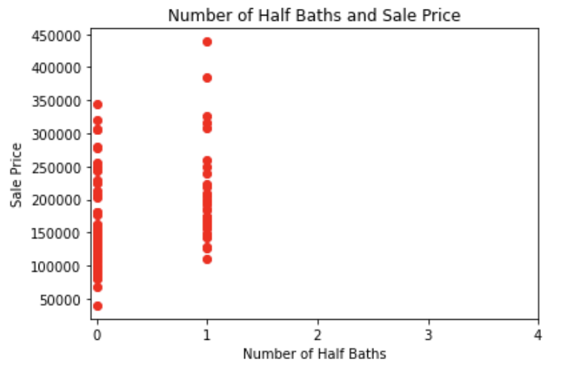
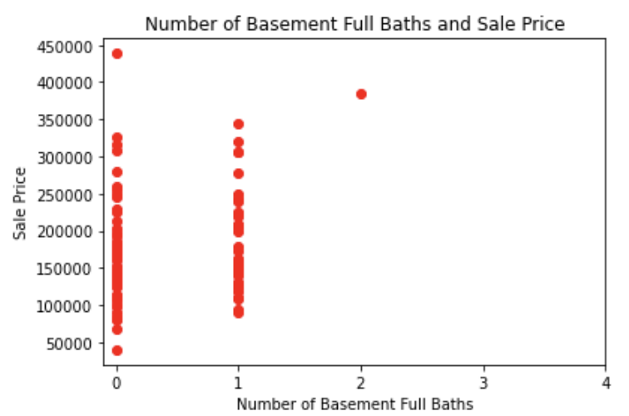
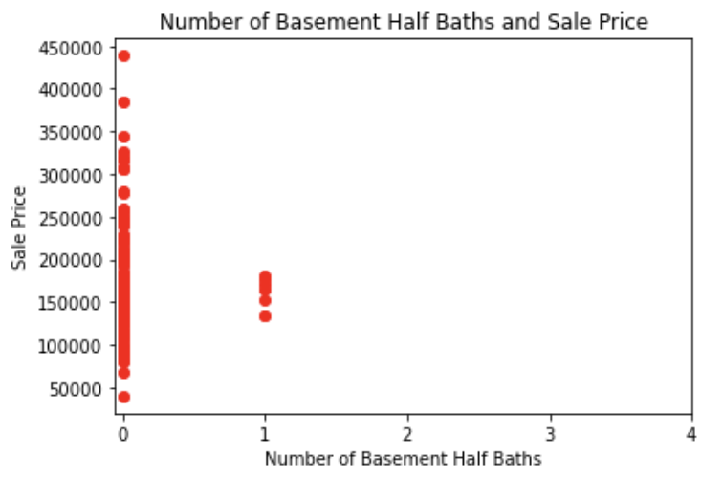
Data Exploration
In Model 2b, the variables HalfBath, BsmtFullBath, and BsmtHalfBath are added to the existing variables in Model 2a.
All are discrete numeric variables. BsmtFullBath has only 3 observed values, while HalfBath and BsmtHalfBath have only 2 observed values.

Slide 11
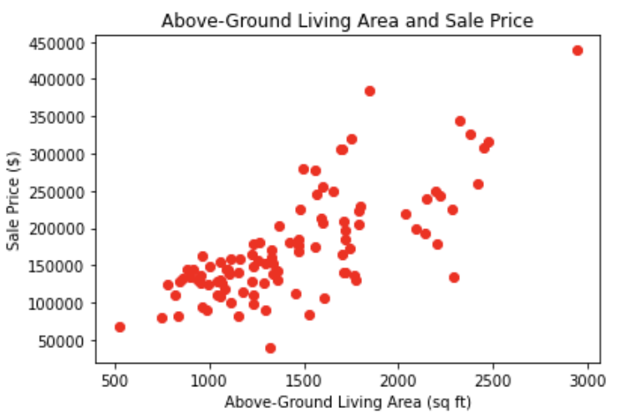
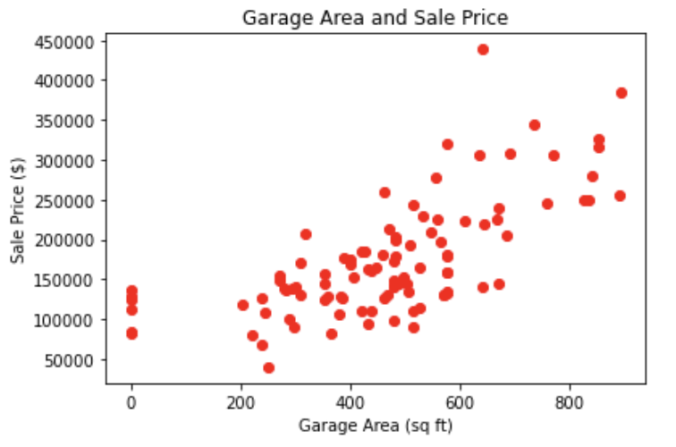
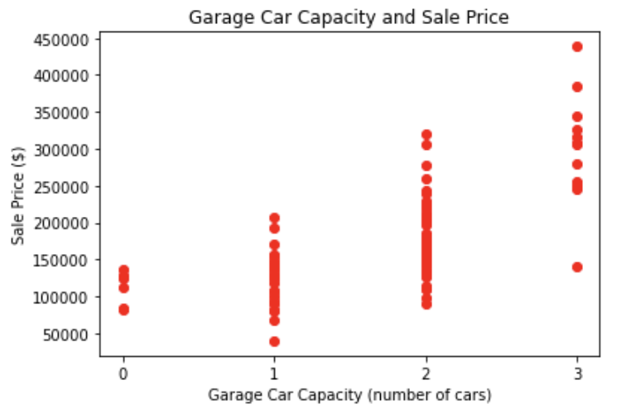
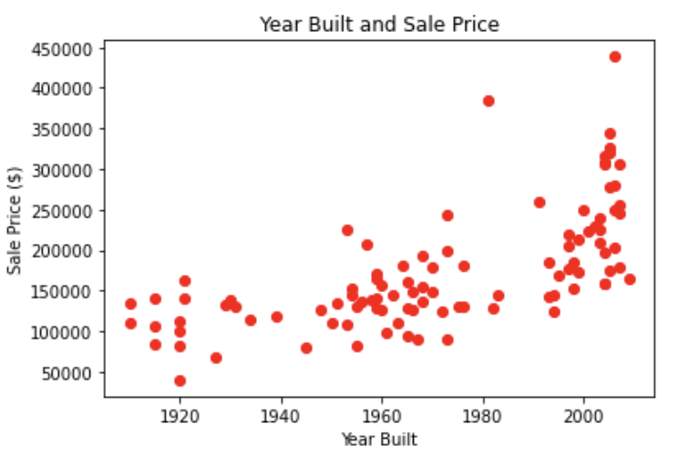
Data Exploration
The variables for the second MIT model are OverallQual*, GrLivArea, GarageArea, GarageCars, and YearBuilt.
All plots show possible linear relationships, although the upward curve at the right of the YearBuilt plot suggests there may be a different relationship between the variables.

Slide 12
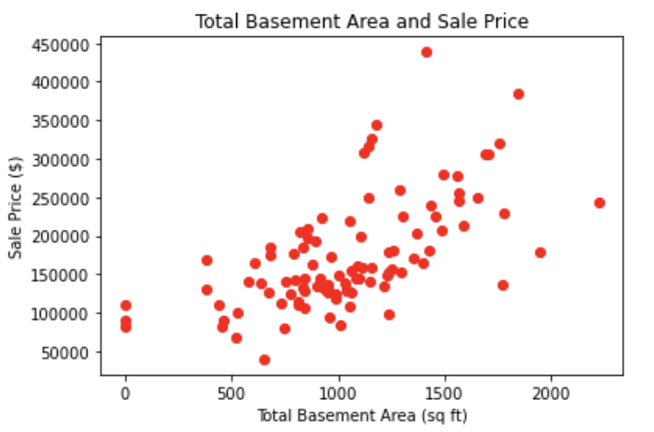
Data Exploration
In Model 3, the variable TotalBsmtSF is added to the existing variables in the second MIT model.
TotalBsmtSF is a continuous numeric variable. The scatter plot shows a possible linear relationship, although the upward curve at the right suggests there may be a different relationship between the variables.

Slide 13
Data Preparation
In the first MIT model, the first 20 records from the original dataset are used as the training set.
In the second MIT model, all 100 records from the original dataset are used as the training set.
Models 1, 2a, and 2b follow the process used in the first MIT model.
Module 3 follows the process used in the second MIT model.
Both training sets are cleaned as follows:
All nonnumeric data is removed.
The remaining null values are replaced using linear interpolation.

Slide 14
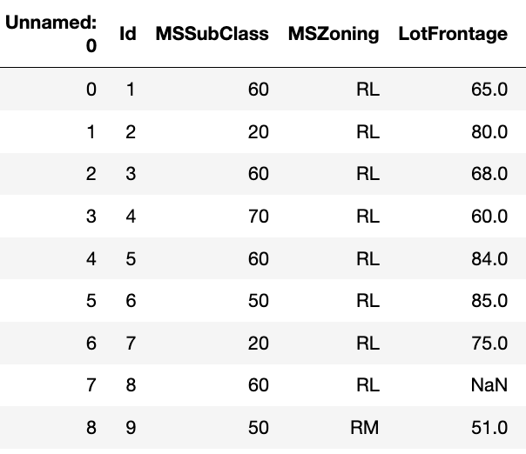
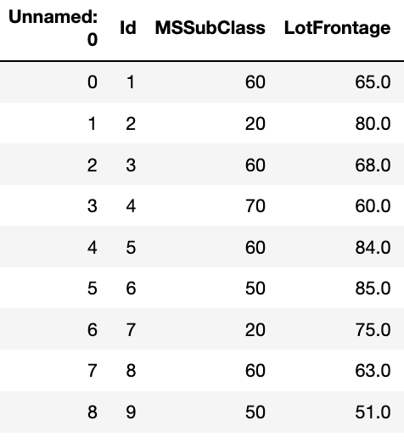
Data Preparation
Training Dataset: Before and After
Before: After:
A subset of the training dataset is shown. All nonnumeric variables, such as MSZoning, have been removed. Null values such as LotFrontage in row 7 have been replaced using linear interpolation ( the average of 75.0 and 51.0 is 63.0).

Slide 15
Correlation
The table below shows the correlation coefficient (r) for SalePrice and each of the other variables in the first training dataset, in descending order.
In the first MIT model, the two independent variables in the regression analysis are selected because they have the strongest correlations with the dependent variable, SalePrice.
Variable | r | Variable | r | Variable | r
SalePrice OverallQual MasVnrArea FullBath TotRmsAbvGrd YearBuilt YearRemodAdd GarageArea BedroomAbvGr GrLivArea TotalBsmtSF GarageYrBlt WoodDeckSF | 1.00 0.81 0.79 0.72 0.70 0.70 0.70 0.70 0.68 0.68 0.65 0.65 0.58 | GarageCars LotFrontage 1stFlrSF 2ndFlrSF BsmtFinSF1 Fireplaces MoSold LotArea BsmtFullBath BsmtUnfSF OpenPorchSF HalfBath BsmtFinSF2 | 0.57 0.51 0.45 0.42 0.40 0.37 0.33 0.27 0.22 0.17 0.13 0.11 0.06 | BsmtHalfBath ScreenPorch 3SsnPorch EnclosedPorch MSSubClass OverallCond YrSold MiscVal Unnamed (ID-0) KitchenAbvGr LowQualFinSF PoolArea | 0.00 -0.13 -0.13 -0.18 -0.20 -0.26 -0.26 -0.28 -0.30 -0.43 NaN NaN
15

Slide 16
Correlation
The table below shows the correlation coefficient (r) for SalePrice and each of the other variables in the second training dataset, in descending order.
In the second MIT model, the five independent variables in the regression analysis are selected because they have the strongest correlations with the dependent variable, SalePrice.
Variable | r | Variable | r | Variable | r
SalePrice OverallQual GrLivArea GarageArea Garage Cars YearBuilt TotalBsmtSF GarageYrBlt FullBath MasVnrArea TotRmsAbvGrd 1stFlrSF YearRemodAdd | 1.00 0.86 0.74 0.69 0.66 0.66 0.62 0.59 0.58 0.57 0.55 0.55 0.55 | LotArea Fireplaces WoodDeckSF 2ndFlrSF BsmtUnfSF HalfBath OpenPorchSF LotFrontage BsmtFinSF1 MoSold BedroomAbvGr BsmtFullBath Screen Porch | 0.50 0.49 0.45 0.38 0.33 0.32 0.30 0.28 0.27 0.26 0.23 0.16 0.04 | 3SsnPorch BsmtHalfBath MSSubClass MiscVal BsmtFinSF2 LowQualFinSF ID Unnamed: 0 OverallCond Enclosed Porch KitchenAbvGr YrSold Pool Area | -0.02 -0.06 -0.07 -0.13 -0.14 -0.15 -0.16 -0.17 -0.23 -0.24 -0.26 NaN
16

Slide 17
Correlation
Variable Selection for the Project
Models 1, 2a, and 2b: Independent variables are selected based on answering questions of interest, rather than on their correlation coefficients. The newly selected variables are added to the existing variables in the first MIT model.
Model 3: The sixth independent variables is selected because it has the sixth strongest correlation with the dependent variable, SalePrice. The newly selected variable is added to the existing variables in the second MIT model.
17

Slide 18
Project Description
Three different models are created based on the MIT models. Variables used in the MIT models are included, and then other variables are added.
Model 1: Adds WoodDeckSF to OverallQual and MasVnrArea
Model 2a: Adds FullBath to OverallQual and MasVnrArea
Model 2b: Adds FullBath, HalfBath, BsmtFullBath, and BsmtHalfBath to OverallQual and MasVnrArea
Model 3: Adds TotalBsmtSF to OverallQual, GrLivArea, GarageArea, GarageCars, and YearBuilt

Slide 19
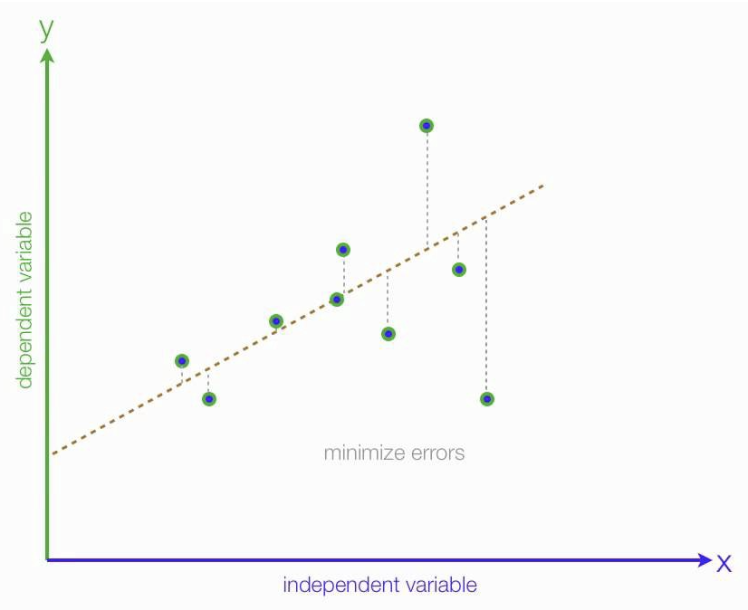
Project Description
A multiple linear regression model is used to analyze the data in this project. The graph below shows a simple linear regression, with two variables.
The regression line minimizes the prediction error for all data points.
Resource: Chugh, 2020

Slide 20
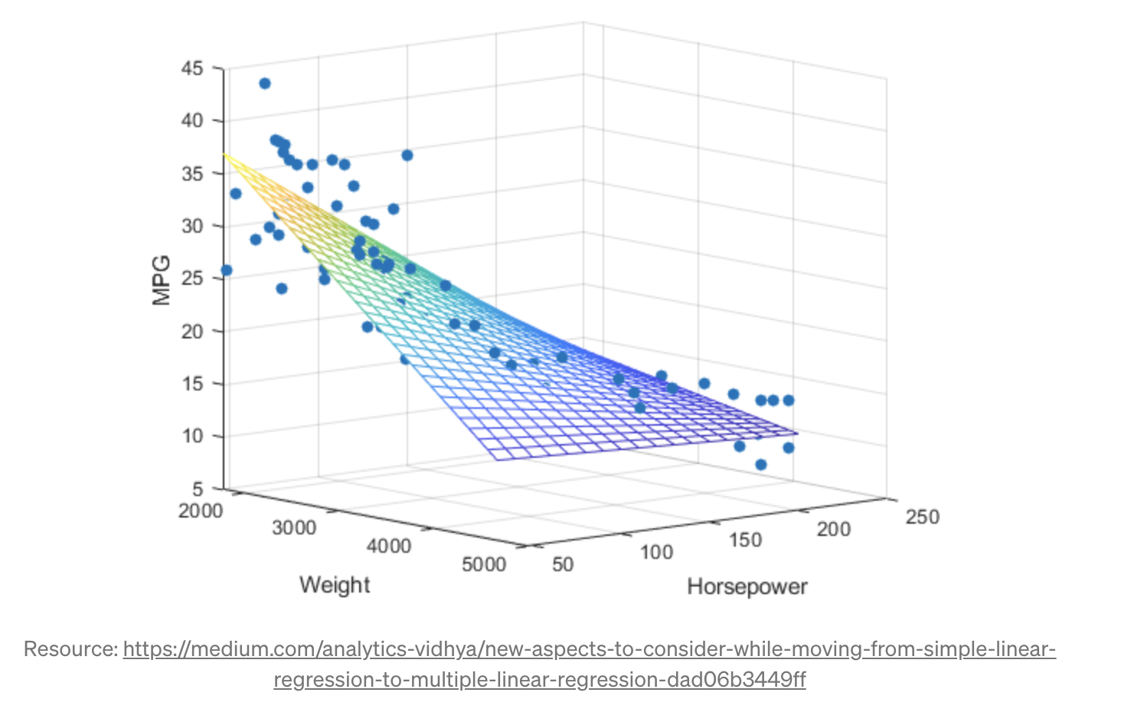
Project Description
The graph below shows a multiple linear regression, with one dependent variable and multiple independent variables.
A fitted hyperplane minimizes the prediction error for all data points.

Slide 21

Project Description
The project uses is the sklearn linear regression model.
To find the optimal hyperplane coefficients, the sklearn model uses the Ordinary Least Squares procedure, derived from Gauss-Markov theorem.
In the equation, 𝛽₀ is the optimized intercept coefficient and 𝛽₁...𝛽_{𝑘} are the optimized coefficients, all of which are estimated in the Ordinary Least Squares procedure. The 𝜖 is the random error.

Slide 22
Project Description
To implement the algorithm using Python:
Store values for the independent variables in a dataframe X.
Store values for the dependent variable in a series Y.
Call the fit method for sklearn linear regression with X and Y as parameters, producing the regression model for the data.
Make predictions using the model by calling the predict method with X as a parameter.
Assess the accuracy of the predictions using R-squared by calling the score method with X and Y as parameters.

Slide 23
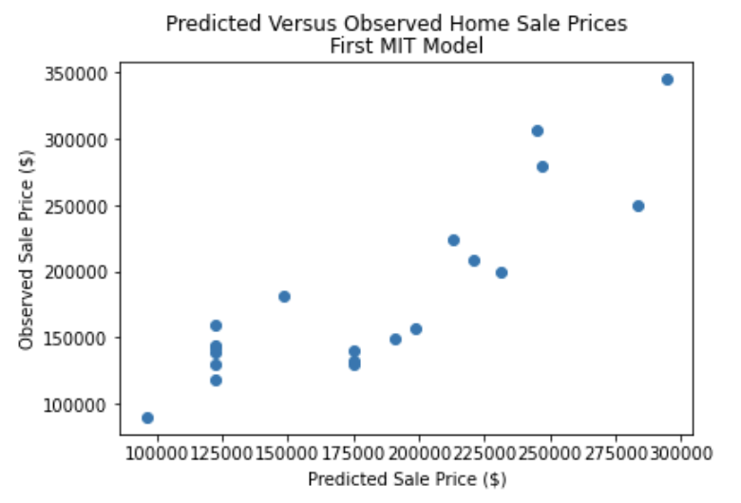
Analysis and Results
The Coefficient of Determination (R²) is given for each model. Scatter plots are also shown. Models 1, 2a, 2b and 3 are compared to the first MIT model, and to each other. Model 3 is compared to the second MIT model.
First MIT Model
R² = 0.7502

Slide 24
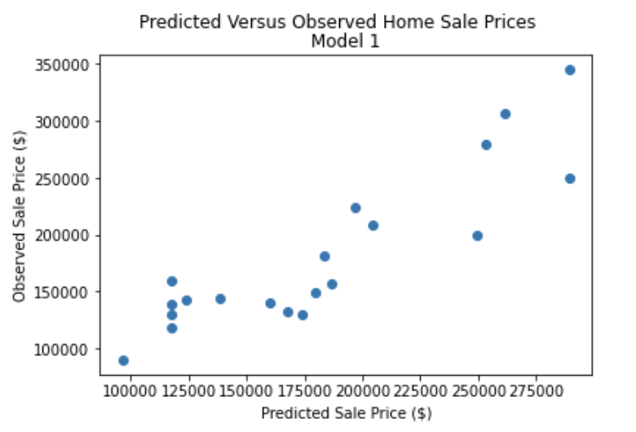
Analysis and Results
Model 1
R² = 0.7882
Model 1 does improve the prediction accuracy of the first MIT model.
0.7882 > 0.7502

Slide 25
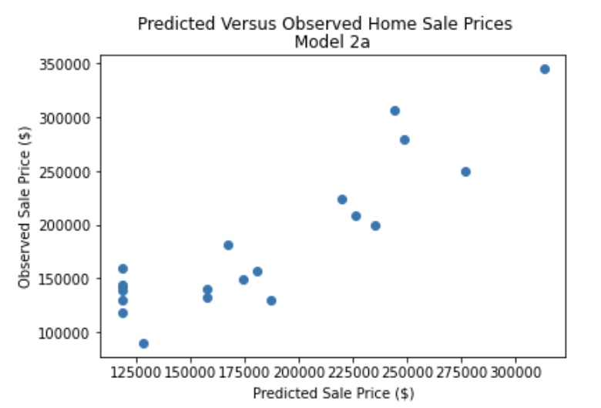
Analysis and Results
Model 2a
R² = 0.7875
Model 2a does improve the prediction accuracy of the first MIT model.
0.7875 > 0.7502

Slide 26
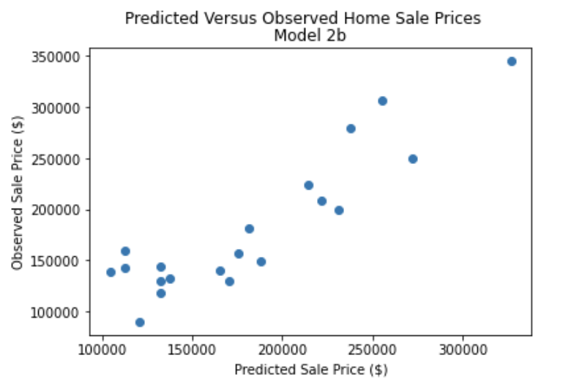
Analysis and Results
Model 2b
R² = 0.8166
Model 2b does improve the prediction accuracy of the first MIT model.
0.8166 > 0.7502

Slide 27
Analysis and Results
Comparison of Project Models
Model 2a (R² = 0.7875 ) and Model 1 (R² = 0.7882)
Model 2a does not improve the prediction accuracy Model 1.
0.7875 < 0.7882
Model 2b (R² = 0.8166 ) and Model 1 (R² = 0.7882)
Model 2b does improve the prediction accuracy Model 1.
0.8166 > 0.7882
Model 2b (R² = 0.8166 ) and Model 2a (R² = 0.7875)
Model 2b does improve the prediction accuracy Model 2a.
0.8166 > 0.7875

Slide 28
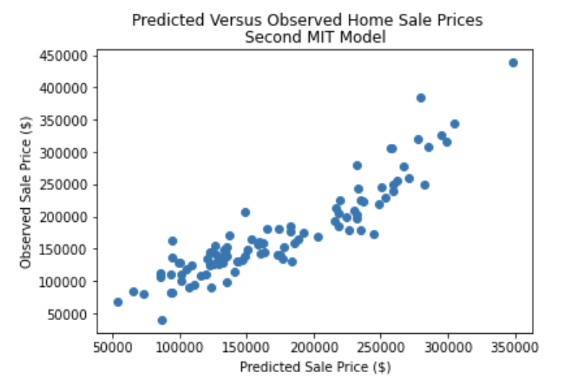
Analysis and Results
Second MIT Model
R² = 0.8310

Slide 29
Analysis and Results
Model 3
R² = 0.8490
Model 3 improves the prediction accuracy of the second MIT model.
0.8490 > 0.8310

Slide 30
Analysis and Results
In addition to the previously given Coefficient of Determination (R-squared), the metrics Mean Absolute Error (MAE), Mean Squared Error (MSE), and Root Mean Squared Error (RMSE) will be computed for each model.
Lower values of the MAE, the MSE, and the RSME all represent a more accurate regression model, while a higher value of R-squared represents a more accurate model.
Metric | Description
Coefficient of Determination (R-squared) | the proportion of variance in the dependent variable that is explained by the linear regression value. The value of R-squared is always less than one.
Mean Absolute Error (MAE) | the average of the absolute difference between predicted and actual values in the dataset. It measures the average of the residuals.
Mean Squared Error (MSE) | the average of the squared difference between predicted and actual values in the dataset. It measures the variance of the residuals.
Root Mean Squared Error (RMSE) | the square root of the Mean Squared Error (MSE). It measures the standard deviation of the residuals.

Slide 31
Analysis and Results
First MIT Model | Value
R-squared | 0.7501
MAE | 29251.6
MSE | 1104293866.6
RMSE | 33230.9
Model 1 | Value
R-squared | 0.7882
MAE | 25729.2
MSE | 936304000.0
RMSE | 30599.1
Model 2a | Value
R-squared | 0.7875
MAE | 26718.7
MSE | 939245456.0
RMSE | 30647.1
Model 2b | Value
R-squared | 0.8166
MAE | 24363.5
MSE | 810836000.2
RMSE | 28475.2
Second MIT Model | Value
R-squared | 0.8310
MAE | 22547.0
MSE | 873115927.3
RMSE | 29548.5
Model 3 | Value
R-squared | 0.7501
MAE | 29251.6
MSE | 1104293866.6
RMSE | 33230.9

Slide 32
Analysis and Results
The tables below compare results using both R-Squared and RMSE metrics, confirming that the accuracy of the predictions are consistent.
Recall that higher values of R-squared represent a more accurate regression model, while lower values of RSME represent a more accurate model.
 | Model 1 |  | First MIT |  | Model 2a |  | First MIT |  | Model 2b |  | First MIT
R² | 0.7882 | > | 0.7502 |  | 0.7875 | > | 0.7502 |  | 0.8166 | > | 0.7502
RMSE | 30599.1 | < | 33230.0 |  | 30647.1 | < | 33230.0 |  | 28475.2 | < | 33230.0
 | Model 1 |  | Model 2a |  | Model 1 |  | Model 2b |  | Model 2a |  | Model 2b
R² | 0.7882 | > | 0.7875 |  | 0.7882 | < | 0.8166 |  | 0.7875 | < | 0.8166
RMSE | 30599.1 | < | 30647.1 |  | 30599.1 | > | 28475.2 |  | 30647.1 | > | 28475.2
 | Model 3 |  | Second MIT
R² | 0.8490 | > | 0.8310
RMSE | 27932.3 | < | 29548.5

Slide 33
Analysis and Results
To summarize, Models 1, 2a, and 2b perform better than the first MIT model, and Model 3 performs better than the second MIT model.
The new models are all additive, i.e., new variables are added to the existing variables in the original models.
Model 2b performs better than Model 2a—again, additional variables are added to existing variables.
Counterintuitively, Model 1 performs slightly better than Model 2a, even though the added variable FullBath in Model 2a has a greater correlation coefficient than the added variable WoodDeckSF in Model 1.
To address the last point, a Seaborn pairplot graph can be used to show relationships between SalePrice, FullBath, and WoodDeckSF.

Slide 34
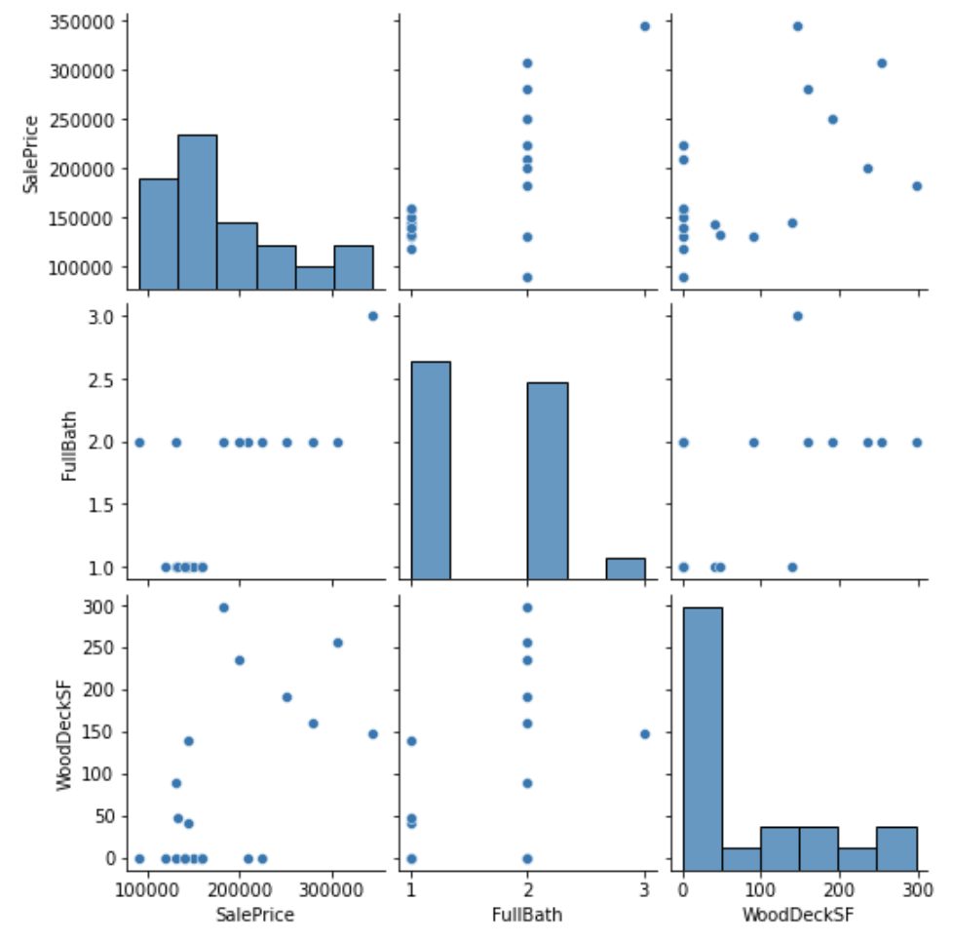
Analysis and Results
The discrepancy between Model 1 (WoodDeckSF) and Model 2a (FullBath) may be attributed to the data values themselves.
FullBath values are integers, with values of 1, 2, or 3. WoodDeckSF values are floating point numbers, with many different values ranging from 0 to 300.

Slide 35
Verification
For all models, prediction accuracy consistently decreases when the models are tested against the test data. Relationships between the models, however, remain consistent when compared to the training results, as shown in the table below.
The decrease in prediction accuracy for the test data could be because the results for the training models are based on the data used to create the training models, while the test data is completely different.
 | Train R² |  | Test R²
First MIT Model | 0.7502 | > | 0.6257
Model 1 | 0.7882 | > | 0.6375
Model 2a | 0.7875 | > | 0.6332
Model 2b | 0.8166 | > | 0.7058
Second MIT Model | 0.8310 | > | 0.8019
Model 3 | 0.8490 | > | 0.8076

Slide 36
Conclusion
For my project, I developed three models based on the first and second MIT models presented in the MIT Data Engineering course.
My Models 1, 2a, and 2b are based on the approach in the first MIT model, which uses a training dataset containing the first 20 observations from the 100 observations in the original data set.
My Model 3 is based on the approach in the second MIT model, which uses a training dataset containing all 100 observations from the original data set.
My conclusions are based on (1) comparing the approaches used in the two MIT models, (2) comparing my models with the corresponding MIT models, and (3) comparing all of my models with each other .

Slide 37
Conclusion
Result 1
The training models based on 100 observations consistently had greater predictive accuracy than the models based on 20 observations, both in initial results and when tested against test data.
Conclusion 1
It is better to include more observations in the training dataset.

Slide 38
Conclusion
Result 2
In all three of my models, adding variables with nonnegative correlation coefficients to existing variables in another model consistently improved predictive accuracy.
Conclusion 2
Predictive accuracy of a multiple regression model can be improved by adding variables with positive coefficients.

Slide 39
Conclusion
Result 3
Adding the variable WoodDeckSF improved predictive accuracy more than adding FullBath, even though FullBath had a stronger correlation with SalePrice than WoodDeckSF.
Conclusion 3
There are factors other than correlation strength that can determine how different variables will affect the predictive accuracy of a multiple linear regression model.

Slide 40
Conclusion
Suggestions for Further Learning
Here are three additional topics I would like to explore after completing this project:
1. How have other researchers analyzed the Ames Housing data?
As I mentioned at the beginning of this report, a Google search on "Ames housing dataset" returns 218,000 results! I look forward to exploring how other data scientists approach this data and to seeing how they present their findings.

Slide 41
Conclusion
2. What else needs to be done to data to improve predictive accuracy?
An example was given in the MIT Data Engineering course of a data set that had a logarithmic distribution rather than a normal one. Taking the logs of the original data values made the analysis more productive. I look forward to exploring techniques for making data better suited for analysis.

Slide 42
Conclusion
3. How could I take a more experimental approach to analyzing data so that I can draw better conclusions?
I found myself repeatedly doing quick-and-dirty “What if?” analyses to see what interesting patterns I could discover. Upon reflection, I would have been more productive if I had been more methodical about the process.

Slide 43
References
Chugh, Akshita. "MAE, MSE, RMSE, Coefficient of Determination, Adjusted R Squared — Which Metric is Better?" Analytics Vidhya, 2020. https://medium.com/analytics-vidhya/mae-mse-rmse-coefficient-of-determination-adjusted-r-squared-which-metric-is-better-cd0326a5697e
de Cock, Dean. "Ames, Iowa: Alternative to the Boston Housing Data as an End of Semester Regression Project." Journal of Statistics Education Volume 19, No. 3(2011). www.amstat.org/publications/jse/v19n3/decock.pdf
Gupta, Alind. "Python: inear Regression Using sklearn." Geeks for Geeks, 2022. https://www.geeksforgeeks.org/python-linear-regression-using-sklearn/
Kargin, Kerem. "Multiple Linear Regression Fundamentals and Modeling in Python." MLearning.ai, 2021. https://medium.com/mlearning-ai/multiple-linear-regression-fundamentals-and-modeling-in-python-60db7095deff
Prasad, Dipanshu."sklearn-Linear Regression under the Hood." Analytics Vidhya, 2020. https://medium.com/analytics-vidhya/sklearn-linear-regression-under-the-hood-31ee71aec00

Slide 44
References
Priya, Lekha. New Aspects to consider while moving from Simple Linear Regression to Multiple Linear Regression." Analytics Vidhya, 2019. https://medium.com/analytics-vidhya/new-aspects-to-consider-while-moving-from-simple-linear-regression-to-multiple-linear-regression-dad06b3449ff
"Sales Prices of Houses in Ames, Iowa." Community Prediction Competition, 2018. https://www.kaggle.com/competitions/stat101ahouseprice/overview
"The 10 Best ROI Home Improvement Projects for 2022." Coldwell Banker Elite, 2022. https://coldwellbankerelite.com/the-10-best-roi-home-improvement-projects-for-2022/
Williams, Dima. "6 Features That Determine a Home's Final Sale Price." Money, 2021. https://money.com/how-to-price-a-home/

